Slide 1
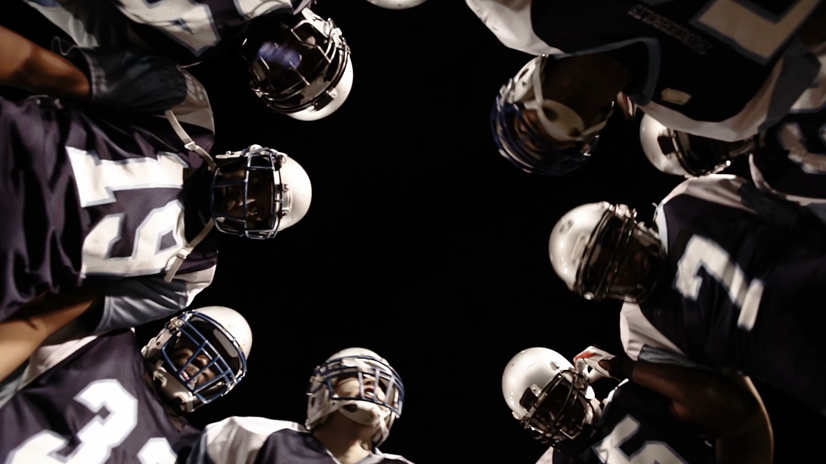
NFL Sports Betting Analysis
Betting for Starters
By: Dario Micucci, Justin Butler,
Rebeca Perez & Brettney Chau-Dang

